Slide 1
Cheetham Jackson monthly update
January 2026

Slide 2
What happened during the month?
January 2026
President Trump’s capture and removal of Nicolás Maduro from Venezuela and subsequent plan for the U.S. to temporarily run the country signalled potential shifts in regional stability and energy markets with implications for investors monitoring geopolitical risk and oil opportunities.
Japan’s January snap‑election call and pro‑growth Prime Minister Sanae Takaichi’s fiscal agenda drove long‑term Japanese bond yields to multi‑decade highs as markets anticipated heavier spending.
Emerging markets began 2026 with strong momentum as EM equities outperformed developed markets, supported by a weaker dollar; South Korea continued its standout run with gains exceeding 20% as SK Hynix and Samsung Electronics continued to surge amid ongoing demand for AI-related memory chips.
Gold and silver saw sharp volatility in January, rallying strongly alongside broader risk‑on sentiment before tumbling abruptly at month‑end.

Slide 3
Performance – Cheetham Jackson
01/02/2026 – 31/01/2026
Source: Morningstar

Slide 4
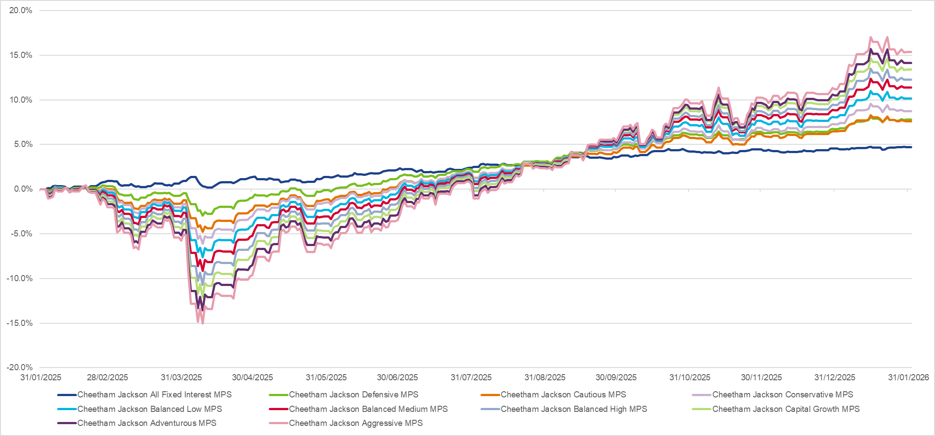
Performance – Cheetham Jackson
01/02/2026 – 31/01/2026
Source: Morningstar

Slide 5
Performance – Responsible
01/02/2026 – 31/01/2026
Source: Morningstar

Slide 6
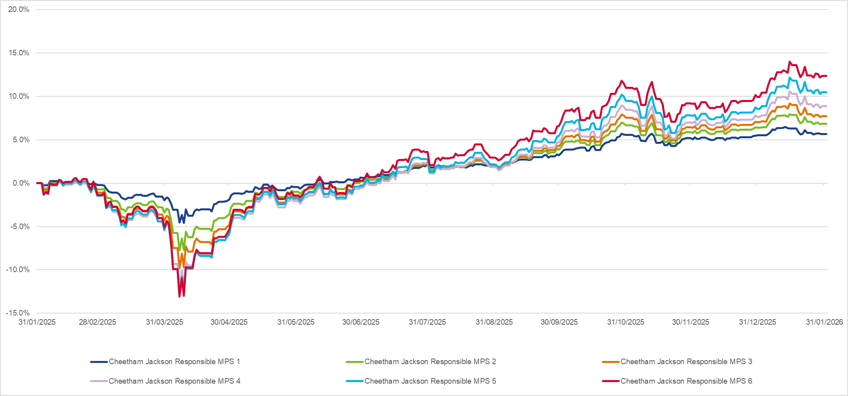
Performance – Responsible
01/02/2026 – 31/01/2026
Source: Morningstar

Slide 7
Portfolio comments
January 2026
iShares MSCI World Energy Sector ETF was the top performer during the month as the index made all time highs.
Prices of metals continued to rise during January before abruptly falling at month end. This translated to gains for some of the miners which make up a section of the iShares S&P 500 Materials Sector ETF.
iShares Core MSCI EM IMI ETF started the year off strongly as South Korea continued its standout run with gains exceeding 20% as SK Hynix and Samsung Electronics surged double digits amid ongoing demand for AI-related memory chips.
iShares Edge MSCI USA Value Factor ETF again continues to perform strongly which has been a huge welcome to the portfolios.

Slide 8
Funds performance
01/01/2026 – 31/01/2026
Source: Morningstar

Slide 9
Funds performance
01/11/2025 – 31/01/2026
Source: Morningstar

Slide 10
Funds performance
01/02/2026 – 31/01/2026
Source: Morningstar

Slide 11
Responsible funds performance
01/01/2026 – 31/01/2026
Source: Morningstar

Slide 12
Responsible funds performance
01/11/2025 – 31/01/2026
Source: Morningstar

Slide 13
Responsible funds performance
01/02/2026 – 31/01/2026
Source: Morningstar

Slide 14
Value and Size Factors
Cheetham Jackson MPS
Source: Morningstar, average for each range rescaled for equity % and long-only positions, Cheetham Jackson Fixed Interest MPS excluded

Slide 15
Value and Size Factors
Cheetham Jackson Responsible MPS
Source: Morningstar, average for each range rescaled for equity % and long-only positions

Slide 16
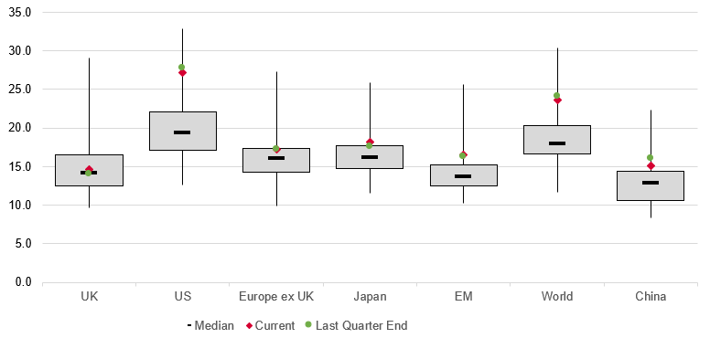
P/E Ratios
Regions
Source: Morningstar

Slide 17
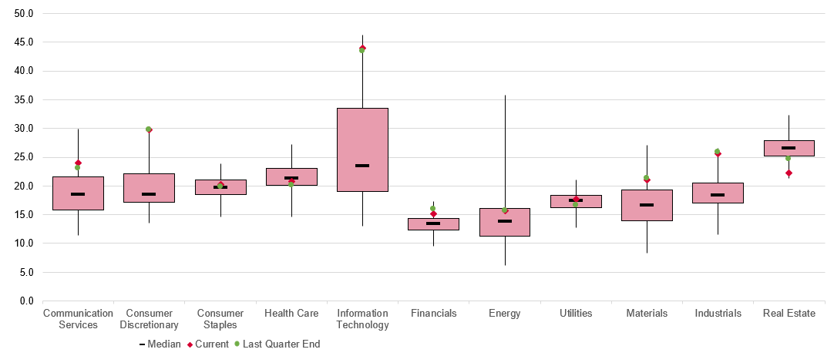
P/E Ratios
Sectors
Source: Morningstar

Slide 18
Thank you
For more information please contact:
Ian Aylward – Head of Investment Partnerships
ian.aylward@ajbell.co.uk
Jack Fairbrother – Portfolio Manager
jack.fairbrother@ajbell.co.uk

