Slide 1

Performance to JANUARY 2026
NOT TO BE LEFT WITH CLIENTS
Date of issue: FEBRUARY 2026
Adviser Tool Kit
Core Portfolios

Slide 2
CJ Portfolio Annualised Return (%)
Name | YTD | 1 Month | 3 Months | 6 Months | 1 Year | 2 Years | 3 Years | 4 Years | 5 Years | 7 Years | St. Dev
CJ Fixed Income | 0.14% | 0.14% | 0.47% | 2.27% | 4.71% | 4.51% | 4.46% | 2.36% | 1.77% | 2.49% | 4.02%
CJ Defensive | 0.97% | 0.97% | 1.56% | 5.44% | 7.78% | 7.08% | 6.14% | 3.90% | 3.61% | 4.44% | 4.76%
CJ Cautious | 1.09% | 1.09% | 1.77% | 5.81% | 7.62% | 7.78% | 6.44% | 3.91% | 3.92% | 4.82% | 5.74%
CJ Conservative | 1.36% | 1.36% | 2.13% | 6.77% | 8.73% | 8.86% | 7.15% | 4.75% | 4.83% | 5.68% | 6.37%
CJ Balanced Low | 1.94% | 1.94% | 2.78% | 8.34% | 10.16% | 10.17% | 8.05% | 5.47% | 5.63% | 6.48% | 7.24%
CJ Balanced Medium | 2.37% | 2.37% | 3.32% | 9.74% | 11.40% | 11.35% | 8.78% | 6.02% | 6.34% | 7.30% | 8.31%
CJ Balanced High | 2.64% | 2.64% | 3.77% | 10.84% | 12.28% | 12.49% | 9.47% | 6.83% | 7.30% | 8.20% | 9.31%
CJ Capital Growth | 3.05% | 3.05% | 4.27% | 12.18% | 13.40% | 13.63% | 10.14% | 7.58% | 8.15% | 9.00% | 10.21%
CJ Adventurous | 3.32% | 3.32% | 4.69% | 13.26% | 14.15% | 14.65% | 10.76% | 8.34% | 9.07% | 9.81% | 11.23%
CJ Aggressive | 3.74% | 3.74% | 5.24% | 14.72% | 15.37% | 15.88% | 11.47% | 9.16% | 10.01% | 10.67% | 12.30%
Returns are simulated using fixed weights. When the holding has not existed for the back testing period (1ST FEB 2019 to 31 JAN 2026) an alternative security or index is used during the period. Returns are gross of any fees charged by AJ Bell, but are after underlying investment charges where appropriate. The value of investments can go down as well as up and you may get back less than you originally invested. Past performance is not a guide to future performance and some investments need to be held for the long term.
SOURCE: AJ Bell Investcentre – Feb 2026

Slide 3
Randomness of Returns (Each Calendar Year)
 | 2017 | 2018 | 2019 | 2020 | 2021 | 2022 | 2023 | 2024 | 2025
CJ All Fixed Income | 1.50% | 3.86% | 4.90% | 3.85% | -0.38% | -5.56% | 5.44% | 3.93% | 5.03%
CJ Defensive | 6.63% | 2.84% | 7.97% | 5.96% | 3.47% | -5.60% | 6.38% | 4.85% | 8.12%
CJ Cautious | 10.40% | 1.75% | 9.35% | 6.53% | 5.39% | -7.53% | 6.74% | 5.68% | 8.40%
CJ Conservative | 13.45% | 0.52% | 10.67% | 7.24% | 6.95% | -6.90% | 7.15% | 6.08% | 9.75%
CJ Balanced Low | 16.35% | -0.17% | 11.98% | 8.04% | 8.63% | -7.42% | 7.74% | 6.66% | 11.06%
CJ Balanced Medium | 19.38% | -1.54% | 13.72% | 9.27% | 10.49% | -8.17% | 8.21% | 7.15% | 12.34%
CJ Balanced High | 22.17% | -3.10% | 15.27% | 9.93% | 12.52% | -7.61% | 8.44% | 7.87% | 13.48%
CJ Capital Growth | 25.06% | -4.13% | 16.54% | 10.57% | 14.25% | -7.08% | 8.54% | 8.48% | 14.56%
CJ Adventurous | 27.88% | -5.41% | 17.88% | 10.90% | 16.31% | -6.50% | 8.72% | 9.16% | 15.56%
CJ Aggressive | 30.81% | -6.57% | 19.26% | 11.45% | 18.28% | -5.94% | 8.85% | 9.75% | 16.81%
Returns are simulated using fixed weights. When the holding has not existed for the back testing period (1ST FEB 2019 to 31 JAN 2026) an alternative security or index is used during the period. Returns are gross of any fees charged by AJ Bell, but are after underlying investment charges where appropriate. The value of investments can go down as well as up and you may get back less than you originally invested. Past performance is not a guide to future performance and some investments need to be held for the long term.
SOURCE: AJ Bell Investcentre – FEB 2026

Slide 4
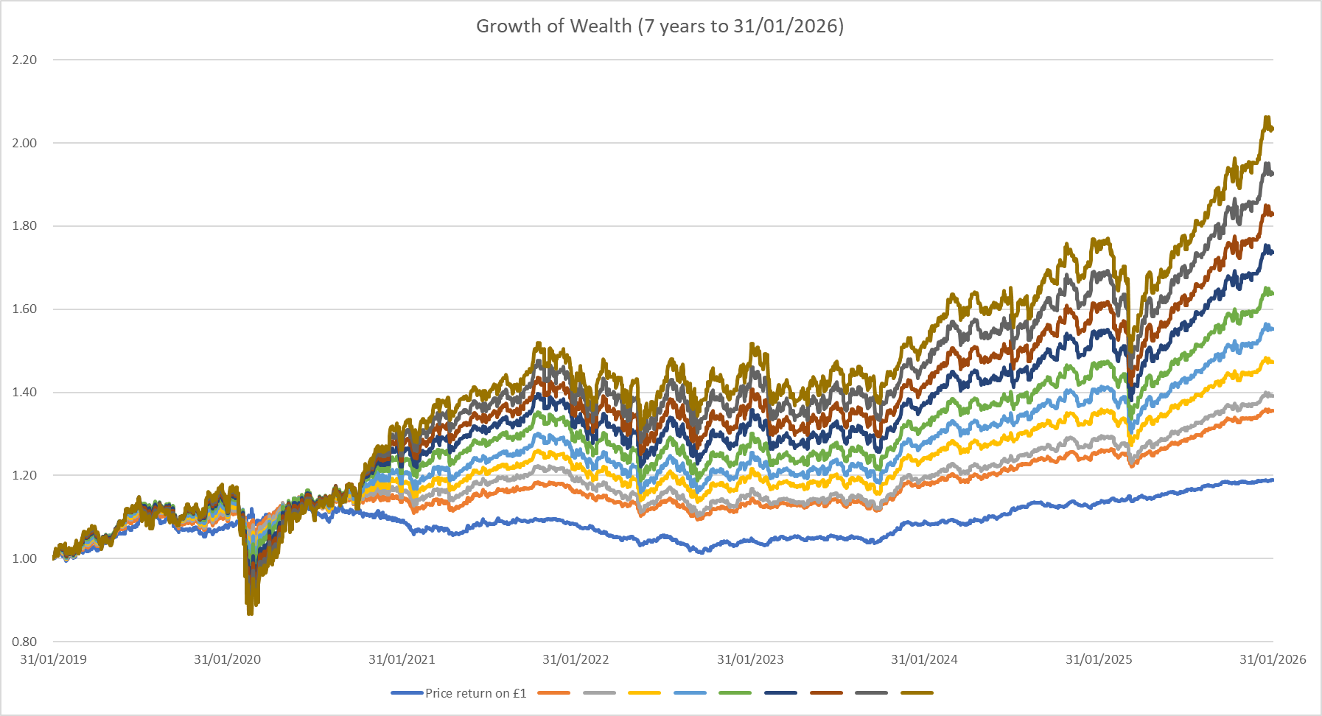
Growth of Wealth
Past Performance is no indication of future performance.
SOURCE: AJ Bell Investcentre – FEB 2026

Slide 5
Range of Returns
Name | Highest | Lowest | Average | Std Dev
CJ All Fixed Income | 3.03% | -2.70% | 0.21% | 1.16%
CJ Defensive | 3.54% | -3.23% | 0.37% | 1.38%
CJ Cautious | 3.79% | -4.52% | 0.41% | 1.66%
CJ Conservative | 3.98% | -5.69% | 0.48% | 1.84%
CJ Balanced Low | 4.61% | -6.55% | 0.55% | 2.09%
CJ Balanced Medium | 5.61% | -7.76% | 0.62% | 2.40%
CJ Balanced High | 6.49% | -9.29% | 0.70% | 2.69%
CJ Capital Growth | 7.23% | -10.33% | 0.76% | 2.95%
CJ Adventurous | 8.37% | -11.46% | 0.84% | 3.24%
CJ Aggressive | 9.43% | -12.57% | 0.91% | 3.55%
Returns are simulated using fixed weights. When the holding has not existed for the back testing period (01/02/2019 TO 31/01/2026) an alternative security or index is used during the period. Returns are gross of any fees charged by AJ Bell, but are after underlying investment charges where appropriate. The value of investments can go down as well as up and you may get back less than you originally invested. Past performance is not a guide to future performance and some investments need to be held for the long term.
SOURCE: AJ Bell Investcentre – AUG 2025

Slide 6
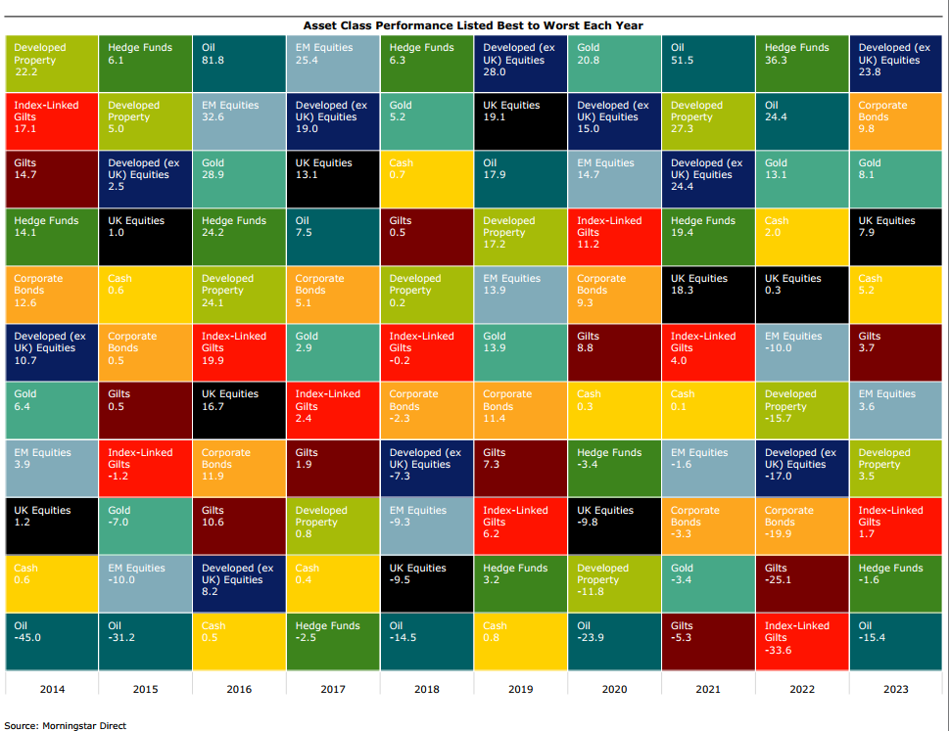
Asset Class Performance Listed Best to Worst Each Year 2014 - 2023
SOURCE:Morningstar –
July 2024

Slide 7
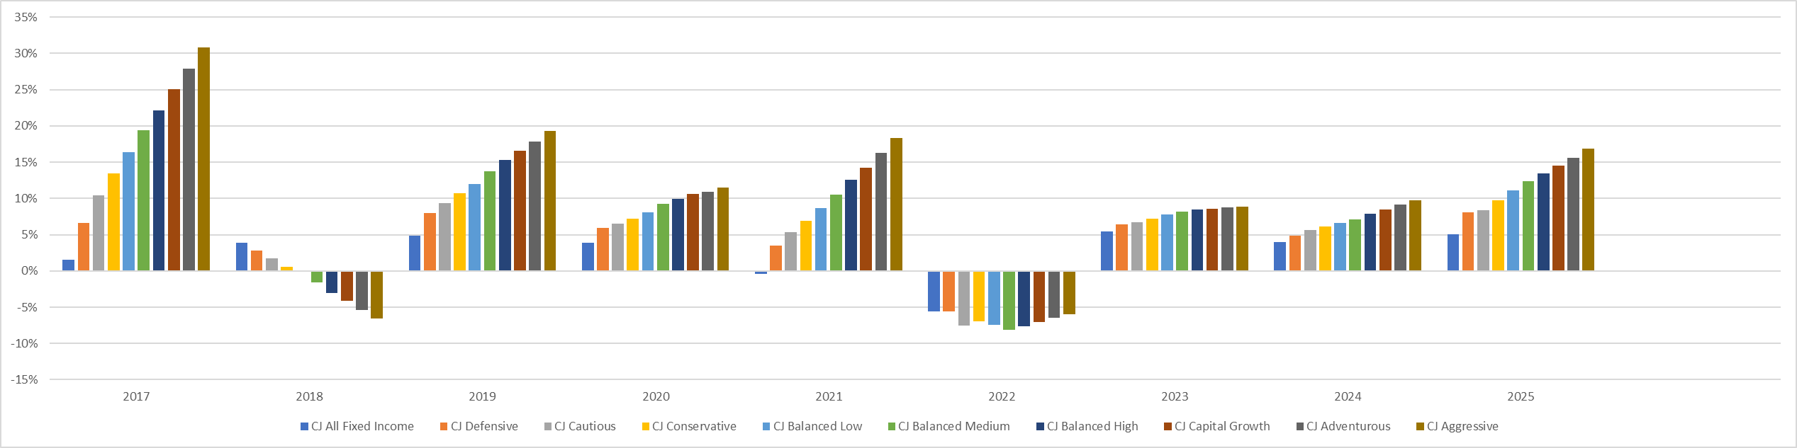
Return Charts (2017 - 2025)
Past Performance is no indication of future performance.
SOURCE: AJ Bell Investcentre – FEB 2026

Slide 8
Return - Standard Deviation Chart
Name | Annualised Return | Annualised Standard Deviation
CJ All Fixed Income | 2.49% | 4.02%
CJ Defensive | 4.44% | 4.76%
CJ Cautious | 4.82% | 5.74%
CJ Conservative | 5.68% | 6.37%
CJ Balanced Low | 6.48% | 7.24%
CJ Balanced Medium | 7.30% | 8.31%
CJ Balanced High | 8.20% | 9.31%
CJ Capital Growth | 9.00% | 10.21%
CJ Adventurous | 9.81% | 11.23%
CJ Aggressive | 10.67% | 12.30%
Returns are simulated using fixed weights. When the holding has not existed for the back testing period (01/02/2019 TO 31/01/2026) an alternative security or index is used during the period. Returns are gross of any fees charged by AJ Bell, but are after underlying investment charges where appropriate. The value of investments can go down as well as up and you may get back less than you originally invested. Past performance is not a guide to future performance and some investments need to be held for the long term.
SOURCE: AJ Bell Investcentre – FEB 2026

Slide 9
Number of Holdings by Fund
Fund | Number of Holdings By Fund
HSBC Global Aggregate Bond S2CHGBP | 5147
iShares £ Ultrashort Bd ESG ETF GBP Inc | 183
iShares ESG Scrn Ovrs Corp BdIdxUKSAcc£H | 7918
iShares Edge MSCI USA Val Fac ETF $ Acc | 157
Xtrackers MSCI World Value ETF 1C | 410
iShares Core MSCI EM IMI ETF USD Acc | 3085
L&G Global Small Cap Eq Idx C GBP Acc | 3413
iShares MSCI USA Md-Cp Eq Wgt UCITS ETF | 319
MPS Cash | 1
iShares S&P 500 Financials Sect ETF $Acc | 82
iShares S&P 500 Matrls Sect ETF USD Acc | 33
Vanguard FTSE Dev €pe exUKEqIdxInsPl£Acc | 423
iShares MSCI Wld Engy Sector ETF USD Inc | 75
Fidelity Index Japan P Acc | 190
 | 21436
Number of Holdings by Portfolio
Model Portfolio | Number of Holdings By Portfolio
CJ All Fixed Income | 13,248
CJ Defensive | 20,822
CJ Cautious | 20,937
CJ Conservative | 21,360
CJ Balanced Low | 21,252
CJ Balanced Medium | 21,252
CJ Balanced High | 21,252
CJ Capital Growth | 21,252
CJ Adventurous | 21,252
CJ Aggressive | 8,187
Important the actual number of holdings is less due to overlap in the portfolios – FEB 2026

Slide 10
Asset Allocation
 | UK | North America | Europe | Japan | Asia | Pacific | EM | Other
CJ All Fixed Income | 12.18% | 43.77% | 22.91% | 4.46% | 2.40% | 4.12% | 7.38% | 2.78%
CJ Defensive | 9.24% | 46.70% | 19.60% | 6.08% | 3.40% | 3.13% | 9.06% | 2.77%
CJ Cautious | 6.42% | 51.34% | 17.70% | 6.06% | 3.45% | 2.30% | 9.96% | 2.77%
CJ Conservative | 4.92% | 50.58% | 18.97% | 6.06% | 4.11% | 1.83% | 10.78% | 2.75%
CJ Balanced Low | 3.67% | 51.98% | 18.36% | 6.50% | 4.38% | 1.38% | 10.99% | 2.74%
CJ Balanced Medium | 3.40% | 52.02% | 17.32% | 6.83% | 5.06% | 1.24% | 11.42% | 2.71%
CJ Balanced High | 3.11% | 53.19% | 16.54% | 6.45% | 5.71% | 1.14% | 11.22% | 2.65%
CJ Capital Growth | 2.90% | 53.79% | 14.81% | 6.32% | 6.59% | 1.02% | 11.97% | 2.60%
CJ Adventurous | 2.54% | 54.02% | 13.71% | 7.12% | 7.08% | 0.86% | 12.08% | 2.59%
CJ Aggressive | 2.28% | 54.06% | 12.67% | 6.96% | 7.95% | 0.72% | 12.82% | 2.54%
 | Bonds & Cash | Basic Materials | Communication Services | Consumer Cyclical | Consumer Defensive | Healthcare | Industrials | Real Estate | Technology | Energy | Financial Services | Utilities
CJ All Fixed Income | 100.00% | 0.00% | 0.00% | 0.00% | 0.00% | 0.00% | 0.00% | 0.00% | 0.00% | 0.00% | 0.00% | 0.00%
CJ Defensive | 80.00% | 0.87% | 1.48% | 2.17% | 0.91% | 1.67% | 2.42% | 0.69% | 5.50% | 0.63% | 3.00% | 0.53%
CJ Cautious | 70.50% | 3.84% | 1.66% | 2.87% | 1.06% | 1.93% | 2.92% | 0.91% | 6.28% | 0.76% | 6.46% | 0.65%
CJ Conservative | 61.00% | 4.81% | 2.08% | 3.81% | 1.51% | 2.74% | 4.28% | 1.21% | 7.74% | 1.03% | 8.62% | 0.95%
CJ Balanced Low | 51.00% | 4.73% | 2.62% | 4.62% | 1.89% | 3.45% | 5.35% | 1.47% | 9.71% | 4.26% | 9.42% | 1.19%
CJ Balanced Medium | 41.00% | 5.17% | 3.22% | 5.59% | 2.32% | 4.23% | 6.57% | 1.79% | 11.90% | 5.53% | 10.89% | 1.45%
CJ Balanced High | 31.00% | 6.52% | 3.69% | 6.55% | 2.70% | 4.95% | 7.69% | 2.12% | 13.68% | 5.80% | 13.19% | 1.69%
CJ Capital Growth | 22.00% | 6.94% | 4.26% | 7.42% | 3.06% | 5.58% | 8.63% | 2.43% | 15.83% | 7.07% | 14.43% | 1.92%
CJ Adventurous | 12.00% | 8.24% | 4.76% | 8.40% | 3.44% | 6.28% | 9.85% | 2.73% | 17.57% | 7.31% | 16.73% | 2.15%
CJ Aggressive | 2.00% | 8.71% | 5.36% | 9.37% | 3.86% | 7.05% | 10.98% | 3.05% | 19.82% | 8.60% | 18.21% | 2.42%
SOURCE: AJ Bell Investcentre –FEB 2026

Slide 11
AEGON/PARMENION Portfolio Return (%)
Name | YTD | 1 Month | 3 Months | 6 Months | 1 Year | 2 Years | 3 Years | 4 Years | 5 Years | 7 Years
AEGON Fixed Income | 0.80 | 0.36 | 0.89 | 2.33 | 5.06 | 9.64 | 14.21 | 9.91 | 8.12 | 13.73
AEGON Defensive | 3.27 | 1.56 | 1.53 | 5.08 | 8.68 | 15.85 | 19.95 | 18.44 | 21.09 | 30.24
AEGON Cautious | 3.44 | 1.65 | 1.64 | 6.39 | 7.76 | 19.31 | 24.24 | 22.66 | 28.84 | 46.35
AEGON Conservative | 3.94 | 1.81 | 1.85 | 7.30 | 8.38 | 21.67 | 26.75 | 26.22 | 34.80 | 55.84
AEGON Balanced Low | 4.32 | 1.99 | 2.02 | 7.97 | 8.71 | 23.57 | 28.79 | 29.59 | 40.67 | 65.02
AEGON Balanced Medium | 4.54 | 2.05 | 2.12 | 8.44 | 8.67 | 25.17 | 30.79 | 33.10 | 47.32 | 75.46
AEGON Balanced High | 4.78 | 2.19 | 2.24 | 8.92 | 9.22 | 26.75 | 32.58 | 36.34 | 52.97 | 84.00
AEGON Capital Growth | 5.01 | 2.31 | 2.37 | 9.32 | 9.32 | 28.04 | 34.04 | 39.20 | 58.27 | 91.60
AEGON Adventurous | 5.19 | 2.40 | 2.48 | 9.66 | 9.47 | 29.18 | 35.31 | 41.81 | 63.25 | 99.22
AEGON Aggressive | 5.34 | 2.49 | 2.55 | 9.98 | 9.68 | 30.26 | 36.54 | 44.15 | 67.62 | 106.19
Returns are simulated using fixed weights. When the holding has not existed for the back testing period (01/02/2019 TO 31/01/2026) an alternative security or index is used during the period. Returns are gross of any fees charged, but are after underlying investment charges where appropriate. The value of investments can go down as well as up and you may get back less than you originally invested. Past performance is not a guide to future performance and some investments need to be held for the long term.
SOURCE: Finalytics – FEB 2026

Slide 12
Soderberg Portfolio Return (%)
Name | YTD | 1 Month | 3 Months | 6 Months | 1 Year | 2 Years | 3 Years | 4 Years | 5 Years | 7 Years
Core Cautious | 1.70 | 0.30 | -0.40 | 4.53 | 7.15 | 22.22 | 33.54 | 29.74 | 37.23 | --
Core Balanced | 1.96 | 0.17 | -1.07 | 5.33 | 7.54 | 27.53 | 42.29 | 40.47 | 52.99 | --
Core Capital Growth | 2.16 | 0.09 | -1.56 | 5.93 | 7.84 | 31.78 | 49.56 | 49.63 | 67.21 | --
Core Adventurous | 1.74 | -0.27 | -2.27 | 5.69 | 6.99 | 33.71 | 54.76 | 55.41 | 77.69 | --
Returns are simulated using fixed weights. When the holding has not existed for the back testing period (01/02/2021 to 31/01/2026) an alternative security or index is used during the period. Returns are gross of any fees charged, but are after underlying investment charges where appropriate. The value of investments can go down as well as up and you may get back less than you originally invested. Past performance is not a guide to future performance and some investments need to be held for the long term.
SOURCE: Finalytics – FEB 2026

