Slide 1


Adviser Training Day
Friday 17th April 2026
Lowry Hotel, Salford

Slide 2
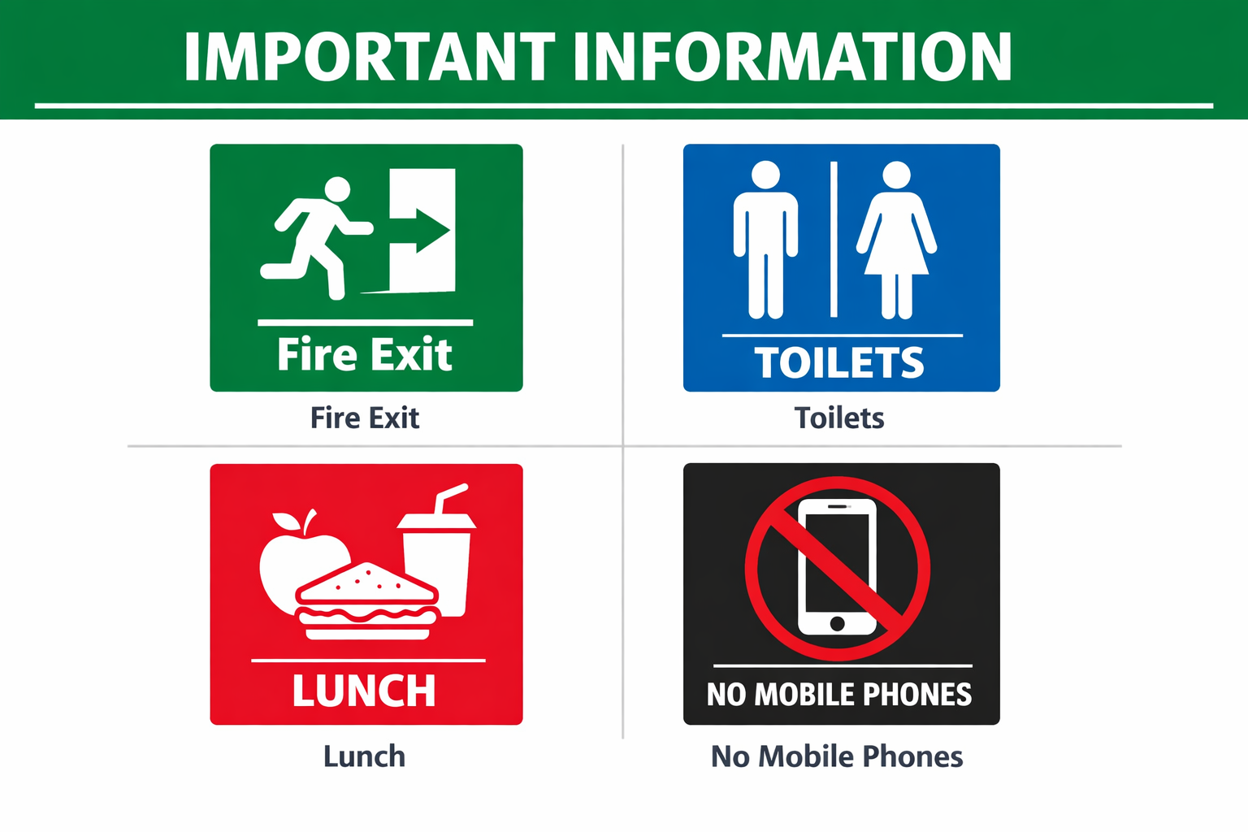

Slide 3
Programme
09:30 – Stuart Gallagher
09:45 – Fredrik : Soderberg: Market Update & Outlook
10:30 – Keith/Hassan: Soderberg Platform Overview
11:15 – Coffee Break
11:30 – Richard: Liberty Estate Planning
12:15 – Suraj: Metro Bank – Trustee Accounts
12:45 – Lunch
13:45 – Jemma : Client Journey
14:30 – Coffee Break
14:45 – Breakout Sessions:
CJ Workplace (Scott)
Review Process (Jemma)
What a Good File Looks Like (Mike)
Partnerships (Dave & Emily)
16:00 – Close

Slide 4


The Soderberg & Partners Platform

Slide 5
Running Order
Context & Evolution
Why bother with a Platform?
A modern Platform – client benefits
Update and upcoming
Hassan, platform in practice

Slide 6
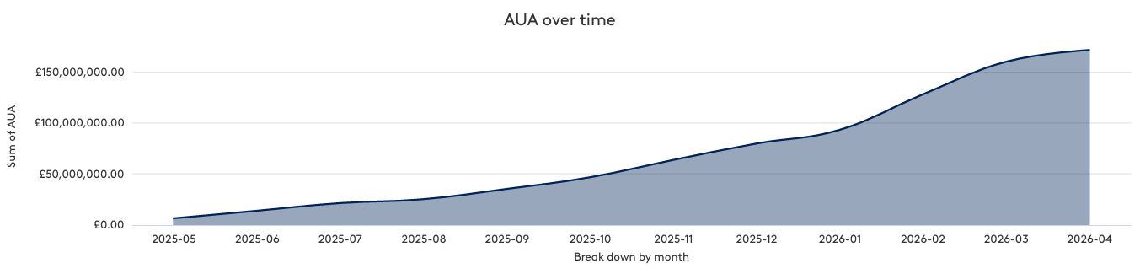
A huge thank you

Slide 7
No-one is short on choice
There are between 30-50 available platforms for retail UK investors
c25 recommended and used by IFAs
Many propositions are becoming increasingly “same as”
Some of the technology is now 20 years old

Slide 8
Platform Evolution
Initially offering greater choice and convenience, eg Cofunds, Skandia, Fidelity. Facilitating “free” advice.
From there to greater transparency, eg RDR, no rebates/clean share classes. Cash accounts.
Rise (and fall) of Model B arrangements.
Consumer Duty presses for greater service consistency and therefore platform rationalisation.
Now we evolve towards “integration” and supporting data provision.
There is no shortage of choice of supporting technology and most areas/problems are covered by suppliers.
IFAs don’t really have an issue with lack of technology, they have too much!

Slide 9
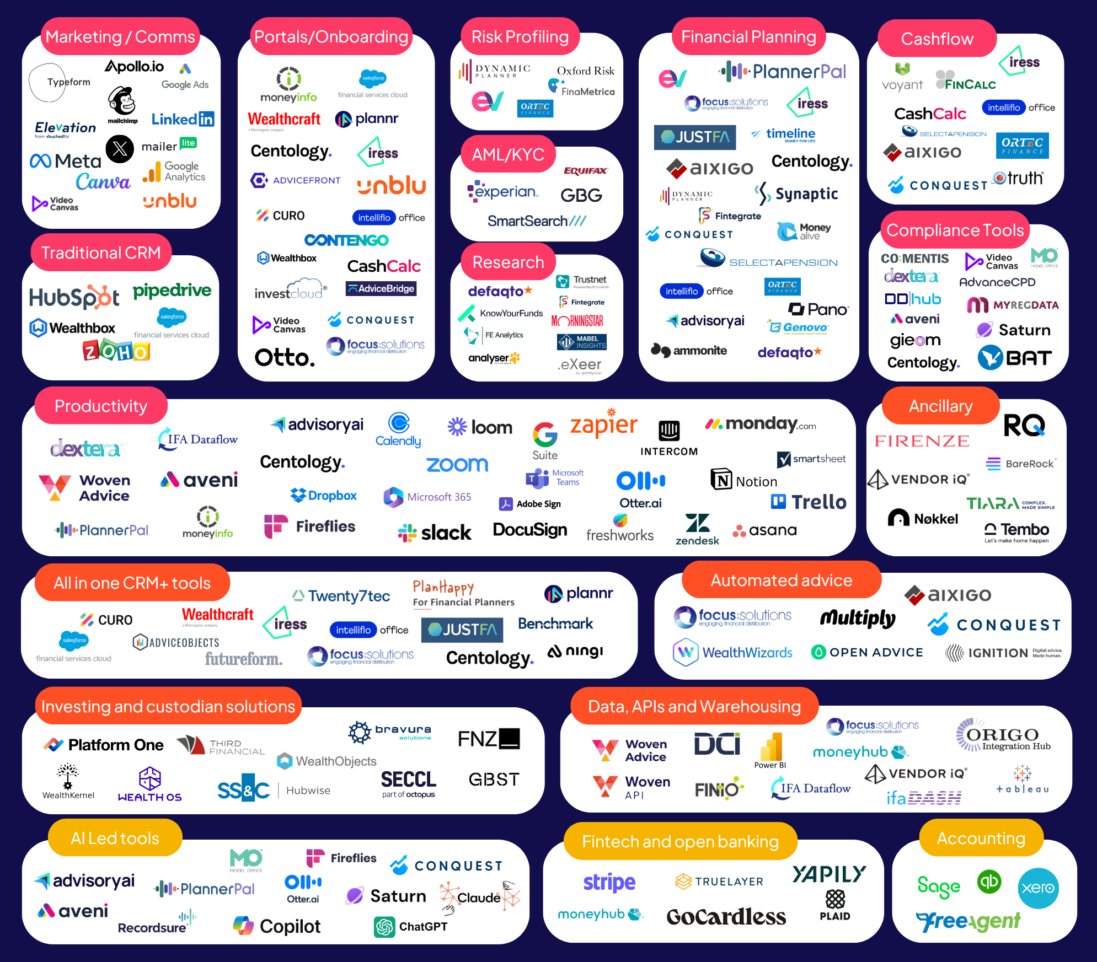

Hundreds of millions
of combinations

Slide 10
Options
1. Ignore new technology, it’s not needed ?
2. Become a pseudo-IT company and source, conduct due diligence, integrate, maintain & update your own tech-stack ?
3. Simplify your tech-stack by working with an end-end solution ?

Slide 11

Why do we have our own Platform?
Much faster, simpler and cheaper to “partner” with existing Platform.
1. Control and Ownership of data.
2. To be the Power behind the end-end tech-stack.
Think iPhone & IoS. The Apps are the fun we all want, but none
work without the IoS system being up to date and powering them.

Slide 12
Working to make the Platform redundant
Q4
2024
Q4
2025
Q4
2025
Q1
2026
Q3
2026
Q4
2026
Report generation
tool
Interactive review pack
ATR
Investment advice
& risk calculation
Execution
of advice
Cash flow
modelling
Fact find &
AI integration
+
Native app
Adviser Copilot
Outsourced & Automated data gathering / LOA Service

Slide 13
Deep & 2way back office integration
Build your illustrations in back office
Complete your research in back office and
send your recommendations via the
Client Portal
Prospect plan is auto-created
Submit the account opening
paperwork to the Client Portal
Client digitally authorises the
transactions
Data seamlessly pushed to the
platform without ever leaving back office.
POS documentation fed back into
back office on completion.

Slide 14
Removal of the Annual client review?
Since RDR and before this has been the bed-rock of ongoing client service, for which the client pays an ongoing fee.
Perhaps, we move to a technology guided continuous suitability and risk monitoring, with human intervention when prompted.
Does that allow access to look after more clients?

Slide 15
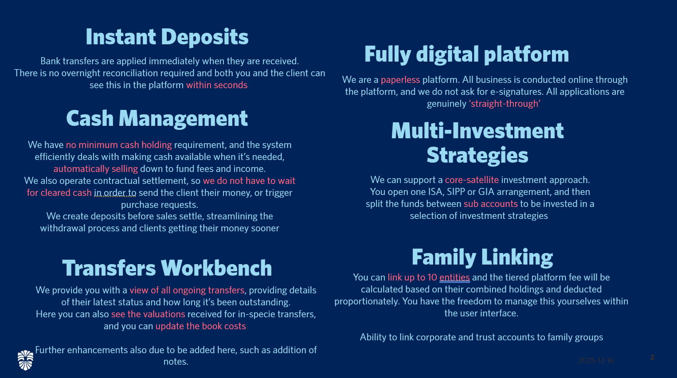

Slide 16
Example Costs
Tiered Annual charge reducing on Total platform AUM.
£200k – 18 bps
£400k – 16 bps
£500k – 15 bps
£750k – 13 bps
£1m – 11 bps
£2m – 8 bps
Including family linking

Slide 17
Current market conditions
Aegon for sale – unlikely to be acquired by someone using their current technology.
FNZ – the “outsourcer” is now “outsourcing” – requires greater due diligence and oversight. How do you access the right people?
FNZ – Just announced a two-tier service proposition…….Quilter, Aberdeen, Scottish Widows, AVIVA, Nucleus*
*Nucleus – to re-platform to FNZ. First announced 2021. Only just moved James Hay in 2026.
“Cash retention and skimming”

Slide 18
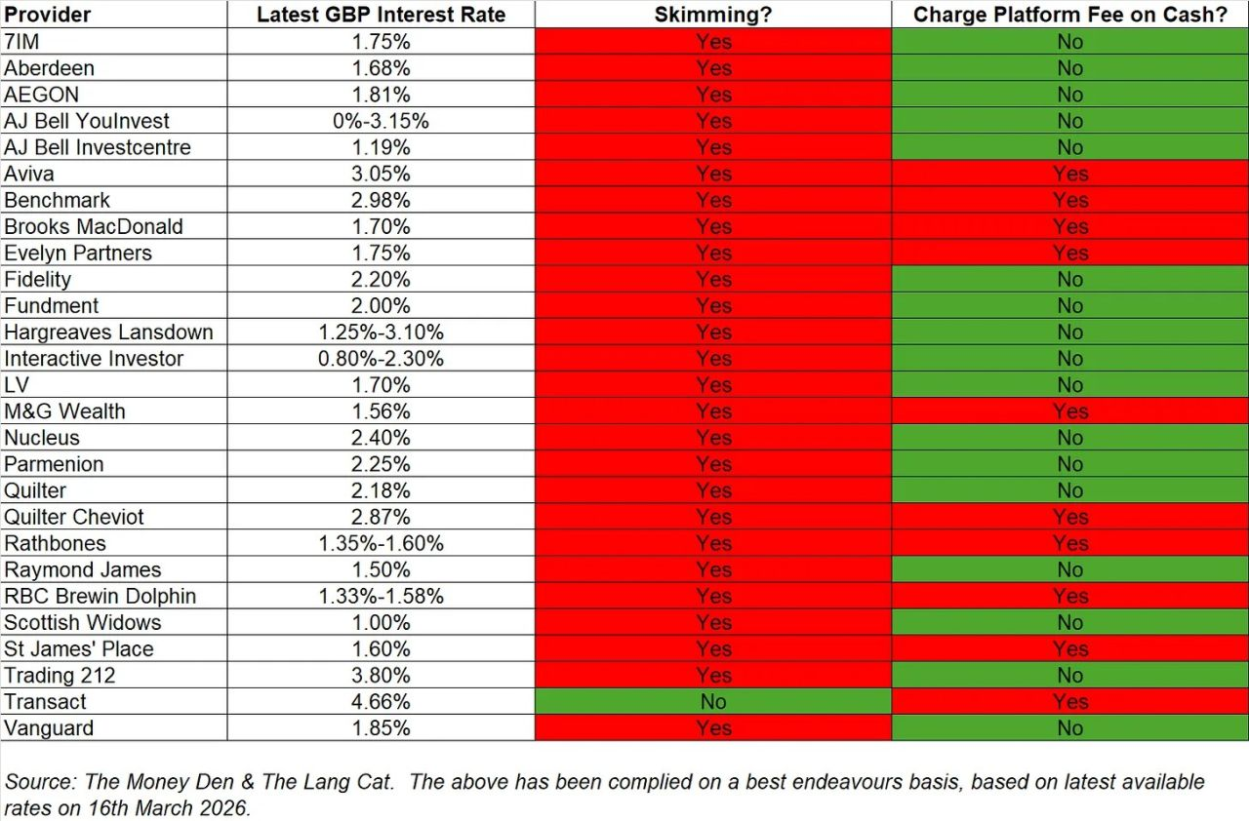

Slide 19
Specifically. M&G
It was January 24 when it first broke that M&G were up for sale and since then it’s been like the Hokey Cokey with announcements around possible sale, wind down closure and MBOs. We are no further forward over two years later.
Reporting shows that customers have been voting with their feet with huge outflows. For example, in Q4 2024 they lost £410m and that has continued since with Q4 2025 showing outflows of over £750m.
Within that time period we have also seen the business about turn and go against regulatory direction and start retaining interest on client cash to prop it up.
The big play for M&G group was to get Pru fund into a wider market, via platform. Since Pru fund was added to FNZ they no longer need their own platform for distribution.
CEO always said he would stay as long as he could to protect his staff and now he's left.
His replacement is an existing M&G man who shows a CV of Regulatory reporting & Financial control. On appointment there have been no statements about carving out a successful future and driving the platform forward.

Slide 20
General Update
£800m + AUM,
First £100m took 371 days. 53 days for the next £100m AUM
Monthly new AUM now c£75m
"in-flight" transfers doubled from £30m to £60m
Several significant bulk Migrations being undertaken
Projection £2bn+ AUM end 2026.
25 Soderberg & Partner firms now using the platform, with 7 in on-boarding now

Slide 21
Scalable technology
Seccl are part of the Octopus group.
£10bn of assets, 3000+ employees
1million client accounts
6million transactions per month
Now processing c 25% of all Uk transfers every day
Doubling in size each year.
Operating a single code base, not building on 15 years old legacy

Slide 22
Platform - Speed of Change
What have we delivered in the last 6 months:
Joint Accounts
Manual transfers appearing on the workbench
Adviser initial fees (%) on cash Transfer-In
Tax Packs
Excess Reportable Income
Fee Funding by value
Firenze (Lombard Lending)
Adviser Group Fees
Transfer Process Improvements
Corporate clients as Trustees
Multi Factor Authentication (MFA)
Transfer updates via the workbench
What’s coming next 6 months:
Bank details will become non-mandatory for client creation (common request – hopefully going live at the end of the month)
Integration into PayUK to speed up a subset of ISA transfers
Introducing Partial GIA & ISA transfers online
Improvements to the workbench to drive efficiencies
Utmost as a third party offshore bond (after TYE)
Nominated accounts for fee collection
Fee flexibility (introduction of a flat ongoing adviser fee and tier defaults)
Advisory model management – to allow advisers to run their models more efficiently
CGT tool enhancements – some delivered pre tye
Additional reports & reporting improvements (not limited to):
  SIPP Beneficiary
  Fee tiering
  Pension Contribution report
Pre-population of data for illustration creation (and a more embedded experience once created)
Further UI improvements:
  Sorting and ordering in key tables
  New Hyperlinks
  New validation rules (more to follow)
  Improve some error messages (more to follow)
Junior SIPP (summer)
Gilts (Q2)
SIPP Prefunding (Q3)

Slide 24

Agenda
Bank details change with client onboarding.
CGT – Scenario based calculations
Cancel transfers
Transfers dashboard
Illustration tab at client level
PPR

Slide 25
Client creation - Before
Shell account
Present illustration.
Illustration submitted
Email sent to client – Provided they pass in NR
Login and accept Ts&Cs
Complete Client details
Client is active
Submit transfers and transact
Account setup is finished.

Slide 26
Client creation - Now
Shell account
Present illustration.
Illustration submitted
Email sent to client – Regardless of whether or not they they pass in NR
Login and accept Ts&Cs – if necessary enter in bank details – if BAV fails then account will remain pending until BAV passes.
Complete Client details
Client is active
Submit transfers and transact
Account setup is finished.

Slide 27


ESTATE PLANNING PARTNERSHIP
&

Slide 28
INTRODUCTION
I’m Richard Ash APFS, Chartered Financial Planner, Step Qualified and Director at Liberty Estate Planning and Liberty Partnership.
I am joined by Jo Stark F.Inst.PA. Jo is our Estate Planning Manager, qualified Paralegal, and Director of Liberty Estate Planning.
Liberty Estate Planning currently has a team of Step Qualified Estate Planning specialist which encompasses all areas of estate planning from Wills and LPAs to Probate.
Notes:
I’m Richard Ash, Director at Liberty Estate Planning. We specialise in estate planning — Wills, Lasting Powers of Attorney, trusts and probate.
My background is financial planning first, with legal structuring supporting that advice. I am a Chartered Financial Planner, a Fellow of the Personal Finance Society, and STEP qualified in trust and estate planning.
I am joined by Jo Stark — Jo is a director, a qualified paralegal, and leads our client process.
We have been speaking with Stuart and the team about partnering with Cheatham Jackson to deliver estate planning services. The purpose of today is to give you a clear understanding of the benefits of what we do, and importantly, how it can fit into your existing client journey.
I have about an hour, so I will focus on a number of key areas that you can start to apply immediately.

Slide 29
WHY LIBERTY?
The business was established in 2007 based on our experience of using solicitors for estate planning services.
What we found was that the process was often costly, could introduce delays, and at times impacted client outcomes due to reliance on third parties. Many of the firms we worked with did not specialise in this area, and were operating across a broad range of legal disciplines.
Our experience has been that estate planning sits between legal and financial advice. Traditional legal services do not always integrate tax planning and financial strategy in a fully joined-up way.
What we do — and what you can now do — is combine financial planning thinking with the appropriate legal structures to deliver a more complete solution for clients.
Notes:
So that gives you a bit of context on who we are.
Let me explain why we built Liberty in the first place, and where we believe the gap in the market still exists.

Slide 30
MARKET ENGAGEMENT
Just a quick show of hands:
  Who here has a Will?
  Who has a Will that includes a trust?
  Who knows what type of trust is in their Will?
  And who is confident on the impact of discretionary trusts on the residence nil rate band?
Notes:
So if that is the gap, the next question is — how big is the opportunity?
Let’s just sense-check the market in the room.

Slide 31
WILL PLANNING
A Will is a legal document that determines how your assets are distributed on death.
Assets held as joint tenants will typically pass by survivorship — for example, joint bank accounts or jointly owned property. However, any assets held in your sole name will require a Will to control distribution.
If someone dies without a Will, this is known as intestacy. In those circumstances, assets are distributed under fixed legal rules, which may not reflect the individual’s wishes, and can lead to delays, disputes, and unnecessary costs.
Notes:
And it highlights something important — even within a room of professionals, there are gaps and uncertainties.
So let’s start with the foundation — Wills

Slide 32
WILL PLANNING
The issues relating to No Will or poor planning, the risks increase:
assets may pass under intestacy rules rather than personal wishes
unmarried partners may receive nothing
children may inherit at an age that is not appropriate
unintended guardians for children.
and benefits may be delayed or paid to unintended recipients
Pension Nominations need also to be reviewed
“One of the most common issues we encounter is outdated pension nominations, particularly following divorce.
If a nomination is not updated, an ex-spouse may still be considered by the trustees when benefits are paid, trustees rely heavily on the most recent expression of wishes — and outdated information creates uncertainty.
In simple terms, small oversights can lead to significant unintended consequences.
Notes:
So that is the core function of a Will. What happens if there is no Will or it has been badly written.

Slide 33
INHERITANCE TAX - KEY ISSUES
From an inheritance tax perspective:
A married couple can combine their nil rate bands, giving up to £650,000 tax free.
The residence nil rate band can add up to £350,000 where assets pass to direct descendants.
There is also a full spouse exemption on first death, and unused allowances can be transferred.
However, structure is critical.
For example, discretionary trusts can prevent direct inheritance by beneficiaries, but depending on how they are used, they may reduce or eliminate access to the residence nil rate band.
In some cases, that could increase inheritance tax by up to £140,000.
The residence nil rate band was only introduced in 2017, and many existing Wills were not drafted with this in mind. As a result, there is a significant review opportunity within existing client banks
Notes:
And then there is inheritance tax to consider

Slide 34
EFFECTIVE WILLS AND TRUSTS
In many cases, effective planning involves the use of a life interest trust on first death.
Typically, part of the estate is placed into trust rather than passing outright. The surviving spouse can benefit — for example, through income or the right to occupy a property — but the trust assets do not form part of their personal estate.
This structure:
  helps ensure assets ultimately pass to intended beneficiaries, typically children
  can prevent assets passing to a new partner — often referred to as sideways disinheritance or blood line planning.
  may offer some protection from care fee assessments, depending on timing and circumstances
This is where good structuring can make a meaningful difference.
Notes:
So if that is the risk, the next question is — what does good planning actually look like in practice?

Slide 35
DEED OF VARIATION
A Deed of Variation allows beneficiaries to redirect inherited assets after death.
It must be completed within two years, requires agreement from affected beneficiaries, and must be properly documented.
It can be used to introduce more appropriate structures — for example, redirecting assets into a life interest trust — and can therefore may offer some protection from care fee assessments.
In practice, it provides a second opportunity to correct planning where a Will has not achieved the desired outcome.
Notes:
That is what we would consider effective planning when it is done properly.
But we often deal with situations where that has not happened — and that is where post-death planning becomes important.

Slide 36
PROBATE
Probate is the legal authority to administer an estate.
A well-structured Will can reduce disputes, improve clarity, and speed up the process. Without that structure, probate can become significantly more time-consuming and costly.
Our approach is to ensure that:
  the Will is in place
  the structure is appropriate
  and the underlying information is known in advance – we suggest individuals store documents with us including a complete financial overview for the probate service. We do not charge for storage.
This allows families to move through the process more efficiently, with less uncertainty and administrative burden, and enables ongoing support for beneficiaries where required.
Notes:
Whether planning is done in advance or corrected after the event, everything ultimately feeds into the probate process.

Slide 37
LASTING POWER OF ATTORNEY (LPA s)
Lasting Powers of Attorney are key legal documents that allow individuals to appoint people they trust to make decisions if they lose mental capacity. They must be registered with the Office of the Public Guardian before they can be used.
There are two types:
  Property and Financial Affairs
  Health and Welfare
Without these in place, your spouse or civil partner has no automatic authority over your sole assets. They would need to apply to the Court of Protection, which can be time consuming, costly, and restrictive, potentially delaying access to funds and decision making.
Notes:
So far, everything we have discussed happens after death.
But a significant amount of risk actually arises during lifetime — particularly around loss of capacity

Slide 38
NO LPAs?)
In the absence of LPAs:
  accounts may be frozen
  property transactions may be delayed
  investments and pensions cannot be managed
  care decisions may be made without family input
And the only route is through the Court of Protection — which is time consuming, costly, and restrictive.
Notes:
And this is where the absence of planning becomes very real, very quickly.

Slide 39
SUMMARY
Without a Will, assets pass under intestacy rules.
Poorly drafted Wills can create tax inefficiencies and unintended outcomes.
Inappropriate trust structures can restrict access or create unnecessary complexity.
And without LPAs, families lose control at critical moments.
Overall, the result is often loss of control, increased tax exposure, delays, and stress for families.
Notes:
So if we step back and look at all of this together, a few key themes start to emerge.

Slide 40
QUESTIONS?
Notes:
That is a high-level overview of the risks and opportunities within estate planning.

Slide 41
Trustee Banking
Professionals Pack

Slide 42
Introduction to the Trust Centre Team
The Trust Centre is a team of 28 trained professionals with a deep understanding of trustee banking.
We are available to assist you or your clients with any questions you may have.
We review all applications and open all trust accounts across the bank.
We then provide ongoing service for any complex queries from the trustees.
Please note, we are not able to give specific trust advice on matters such as trust structures, tax implications, legal matters, TRS registration/exemptions etc.
There are two ways you can contact us:
Trust Centre Main Contact Number - 0203 402 8093. This number is manned within office hours.
Inbox for completed applications (15 working days SLA) – trustaccountopening@metrobank.plc.uk
Enquiries Inbox (2 working days SLA )– trust.enquiries@metrobank.plc.uk

Slide 43
Metro Bank Trustee Banking Proposition
Metro Bank can provide a streamlined trust account proposition to customers focused on convenience, immediacy of account opening and ongoing service.
We accept applications completed in store and from professional advisors such as solicitors or IFAs
The cornerstones of our proposition are:
A fully operational transaction account in the name of the trust – cheque book facility but no debit card
Online banking which can be tailored to the needs of the trustees. Standard (Free of charge) and Dual Sign Online Banking
(additional £5 per month) available.
A dedicated trust account opening team able to provide an active trust account within 15 working days
An email inbox accepting completed trust applications direct from advisory firms.
Ongoing relationship management of trustees provided Trust Centre
A hotline professional advisors or trustees to call/email should they have any queries
Fee Structure:
We charge an account opening fee of £150 per trust account. This will be debited automatically from the trust account once initial funds have been received.
If the account holds less than £25k then it will also be subject to a monthly £5 account maintenance fee
Notes:
Discuss online banking restrictions for complex mandates
Mobile banking is view only even for 1 to sign mandates
Currently due to a defect, customers cannot set up standing orders on their standard online banking platform

Slide 44

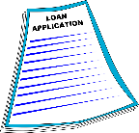

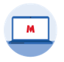

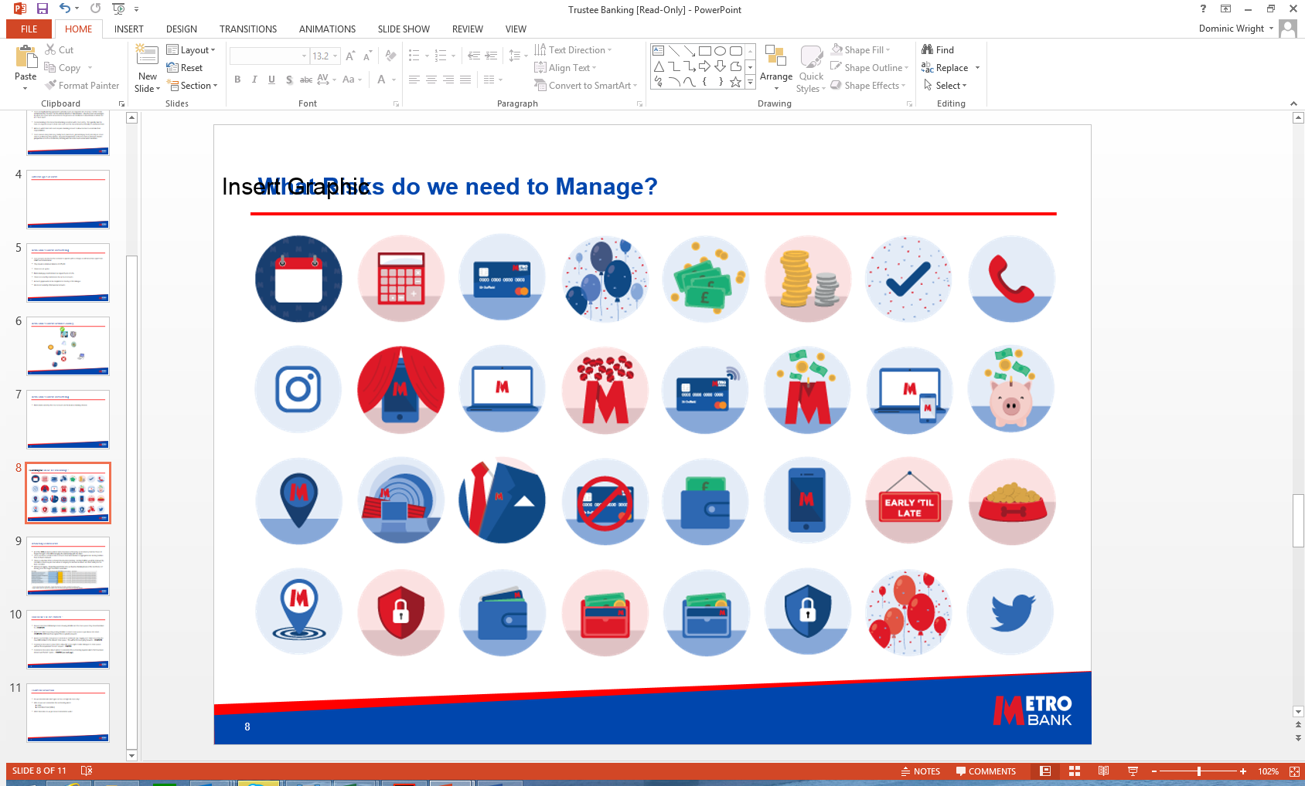




How do we Operate the Trust Centre?
Trust Centre will open ALL trust accounts and liaise directly with trustees
Completed
Application Form
Advisor meets with client
Client and advisor jointly complete documents
TRUST CENTRE
ID Trustees
Certified Trust deed
Trust Centre will handle all customer and introducer relations
Customer can attend any Store
Sit with Bank colleague
TRS Confirmation of Registration Document

Slide 45
Requirements for Opening a Trust Account
Below is a list of what is required to get an active trust
A completed trust account application form signed by ALL trustees
A certified copy of the trust deed (also require a certified death certificate if this is a Will trust)
Confirmation of registration on HMRC’s Trust Registration Service, or a valid exemption reason. N/B all trustees, settlors and beneficiaries declared to TRS must also be listed on the trust application form.
An individual ID&V form - 1 completed per trustee
1x ID & 1x proof of address documents per trustee. These must be certified.
All named beneficiary and settlor details to be added to the application form. The Trust Centre will then undertake EID&V to verify their identity. If this online verification fails, we may request paper ID and/or proof of address documents from the lead trustee.
Please note…..
Metro Bank’s risk appetite requires us to decline any trusts that are registered overseas OR have the majority of KAPs residing overseas OR have exposure to any high-risk geographic locations. Please speak to us if you have any concerns about risk factors before commencing an application.

Slide 46
What happens once the account pack is completed?
Once all documents are completed you need to email the pack to trustaccountopening@metrobank.plc.uk
We will review the pack and respond to the professional advisor if we have any questions
We will then open the trust account within 15 business days of receiving a completed application.
Once the account is open, we will communicate directly with the trustees/signatories. We will:
  Email a welcome letter to each trustee/signatory containing account details and their 12 digit customer number
  This email will be encrypted and we will text the access password to their mobile phone
  The customer will then receive a letter within 3 business days confirming their Magic Word.
The customer can then register for online and telephony banking using MB registration portal.
We will also email the introducing agent to let them know the account is active.

Slide 47


Next Steps
If you are interested in hearing more, please contact Suraj Madlani Business Development Director on Suraj.Madlani@merobank.plc.uk or 07980691414 or Damian Cliff Local Director on Damian.Cliff@metrobank.plc.uk or 07967 824950.
Trust Centre contact details are:
Phone - 0203 402 8093
Email - Trust.enquiries@metrobank.plc.uk

